Slide 1
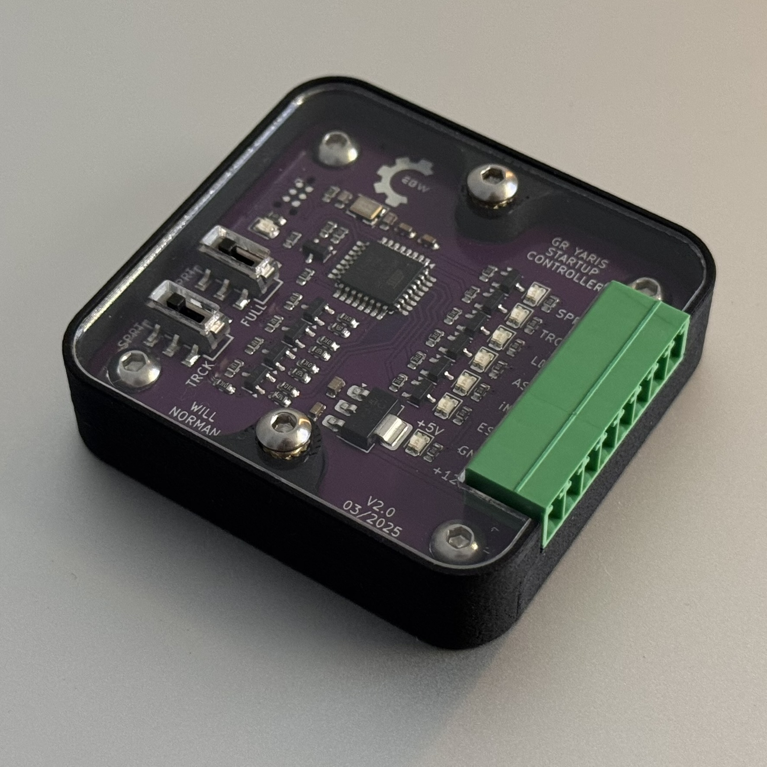
GR Yaris Startup Controller V2.0
Overview & Installation Guide
I TAKE NO RESPONSIBILITY FOR ANY DAMAGE CAUSED DURING THE INSTALLATION OR OPERATION OF THE DEVICE.
INSTALL AT YOUR OWN RISK
WILLN on GR-Yaris.co.uk
will.norman@sky.com
GitHub project files
05/04/25

Slide 2
2. Overview - Operation
Every time the car ignition powers on, the “GR Yaris Startup Controller” turns on and automatically:
Switches off the lane departure alert
Switches off auto stop/start
Switches on iMT
Selects the driving mode (sport/track)
Turns ESC to expert mode or fully off
It does this by mimicking button presses electronically (no CAN bus sophistication, just button presses).
Original button press functionality remains unaffected.
Link to forum post where idea initially shared by MagnusT
If you don’t want all the buttons pressed, wire only the ones you desire and leave the rest unpopulated.
If you don’t feel comfortable splicing into the factory wiring (like me), you can buy short extension harnesses that can be spliced into. See links on subsequent slides for where to purchase these extensions.

Slide 3
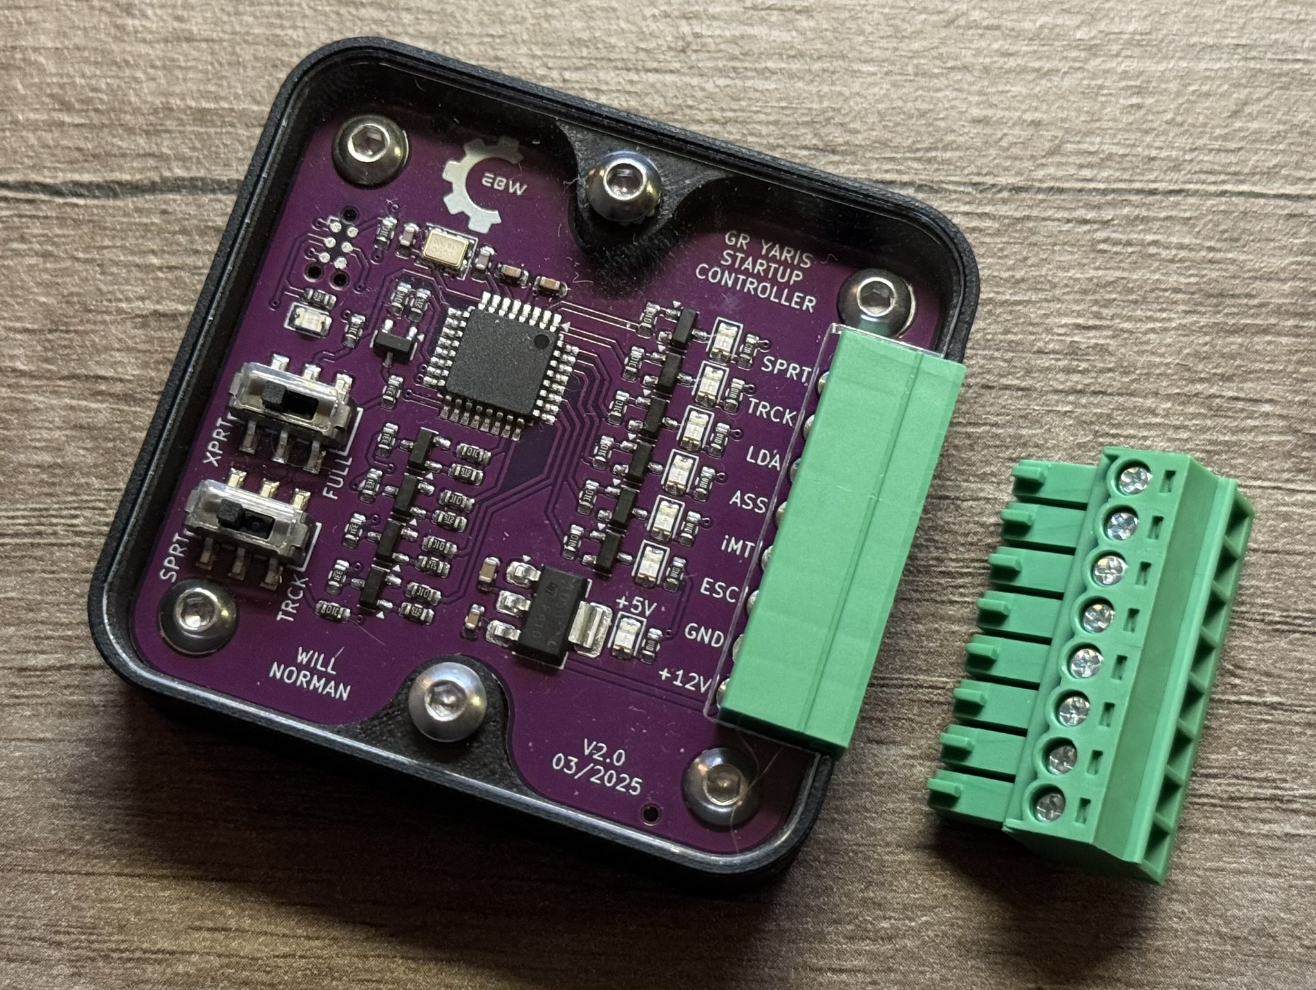
3. Overview - Design
Indicator LEDs
ESC Select Switch
Expert mode (XPRT) – short button press
ESC fully off (FULL) – long button press
Drive Mode Select Switch
Sport (SPRT)
Track (TRCK)
Pinout Text
Pluggable Screw Terminal
Power Indicator LED

Slide 4
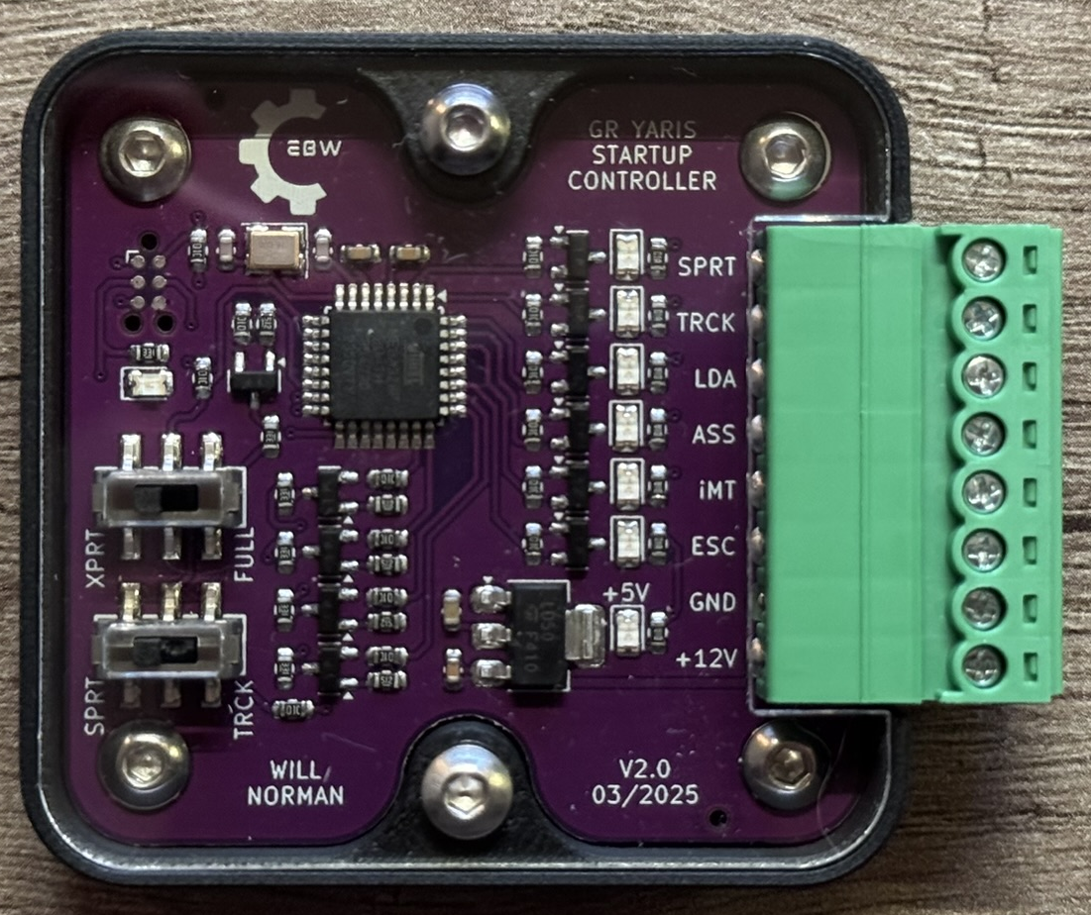
4. Controller Wiring
8. SPRT - Sport Mode (page 8)
7. TRCK - Track Mode (page 8)
6. LDA - Lane Departure Alert (page 6)
5. ASS - Auto Stop/Start (page 7)
4. iMT (page 7)
3. ESC – Stability/Traction Control (page 7)
2. GND (page 5)
1. +12V (page 5)
OEM wiring
Controller wiring tee-d off

Slide 5
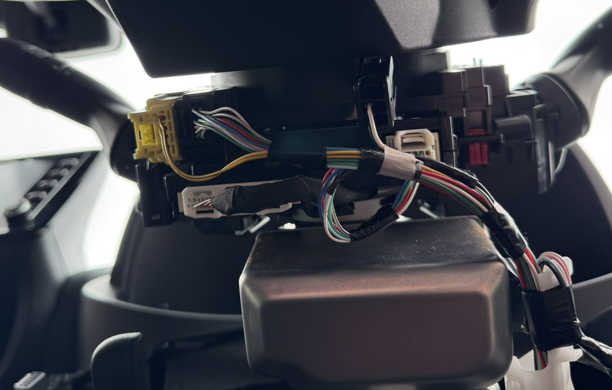
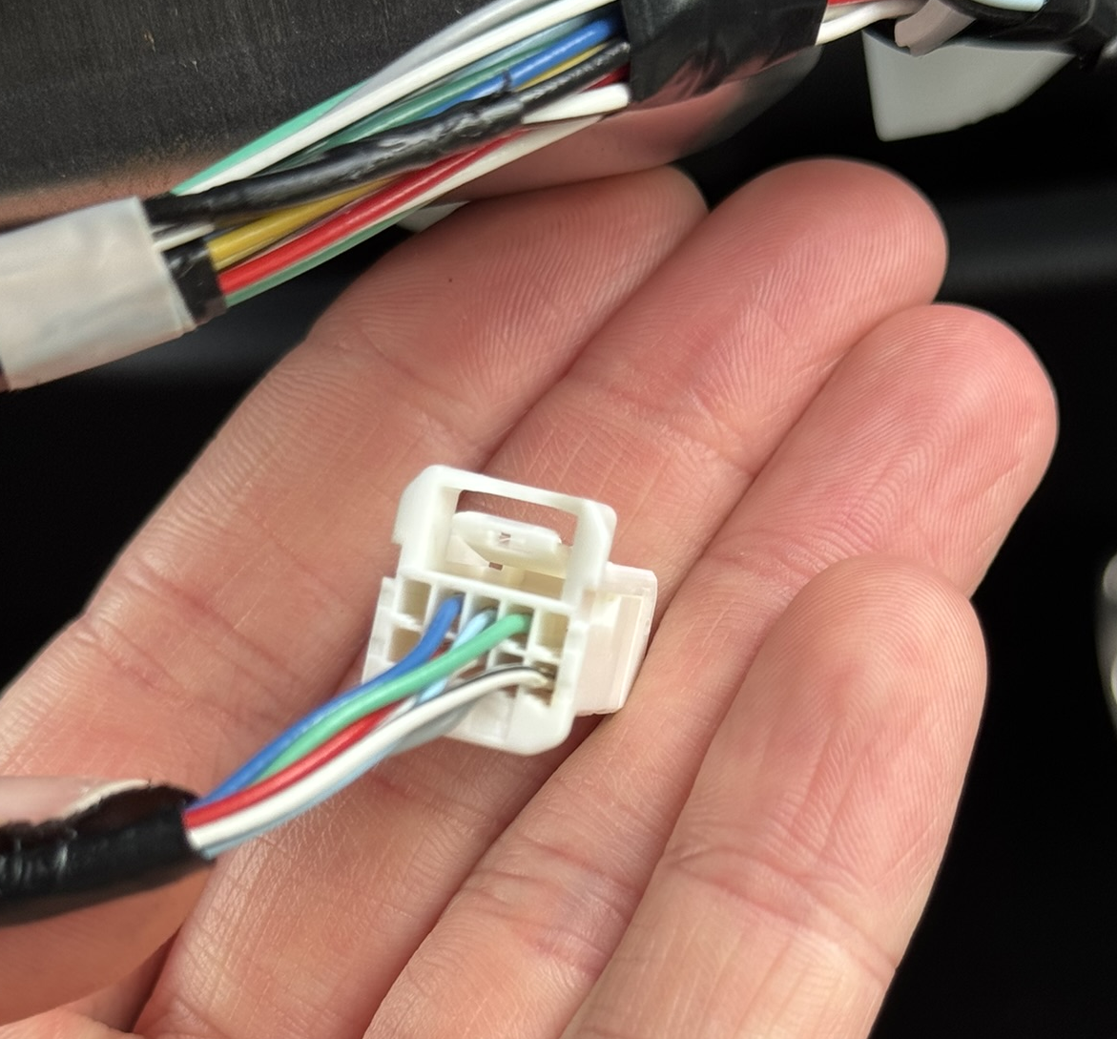
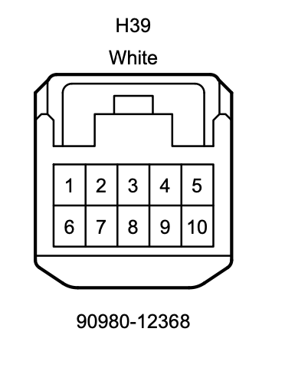
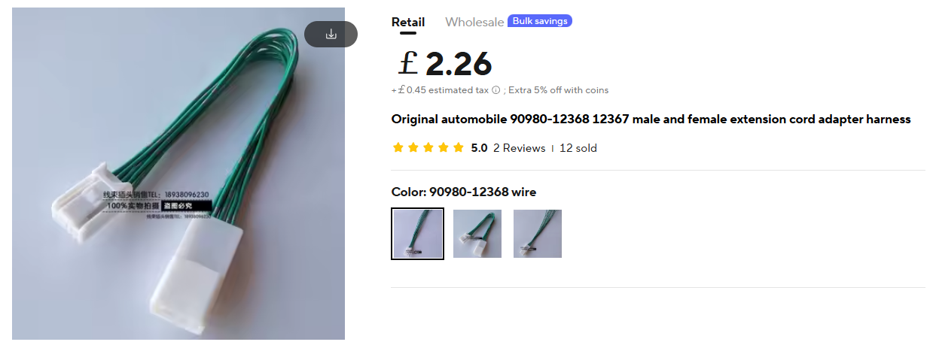
5. Ignition Power + Ground
The wiring for +12V & GND is found under the steering wheel cowling on the 10-pin plug.
The cowling is removed by undoing 3x screws (rotate the steering wheel to reveal 2 hidden screws)
Pin number 9 (Red) = +12V
Pin number 6 (White & black stripe) = GND
If you don’t want to splice into the factory wiring, short extension harnesses can be purchased here that you can modify:
10-pin extension harness
Another option that should work

Slide 6
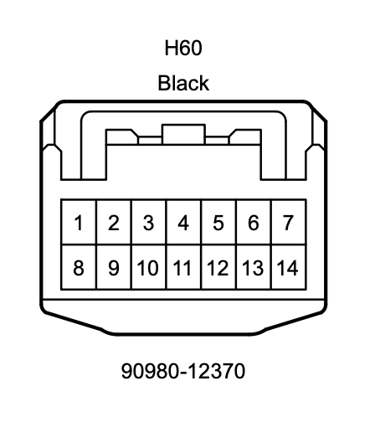
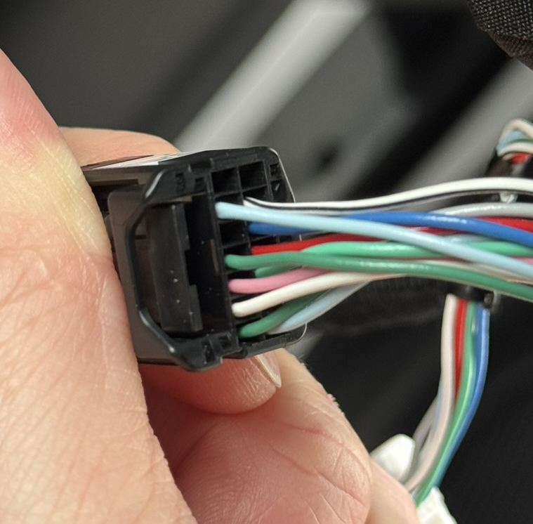
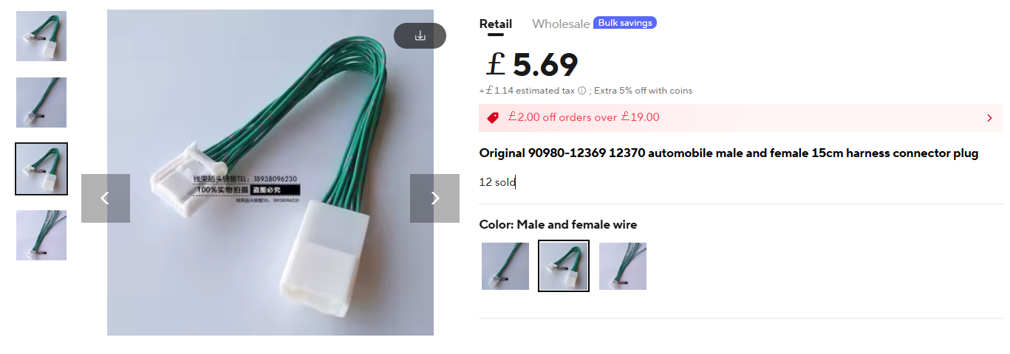
6. Lane Departure Alert
The wiring for LDA is also found under the steering wheel cowling, but on the 14-pin connector
Pin number 6 (White) = Lane Departure Alert (LDA)
If you don’t want to splice into the factory wiring, short extension harnesses can be purchased here that you can modify:
14-pin extension harness

Slide 7
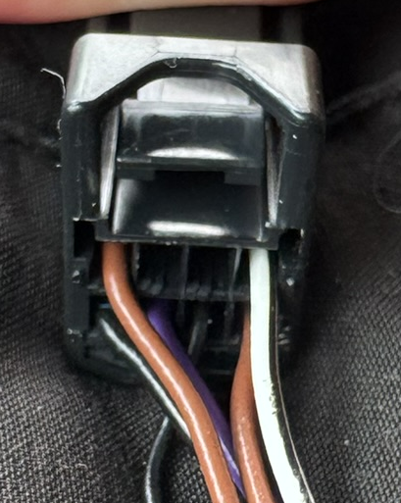
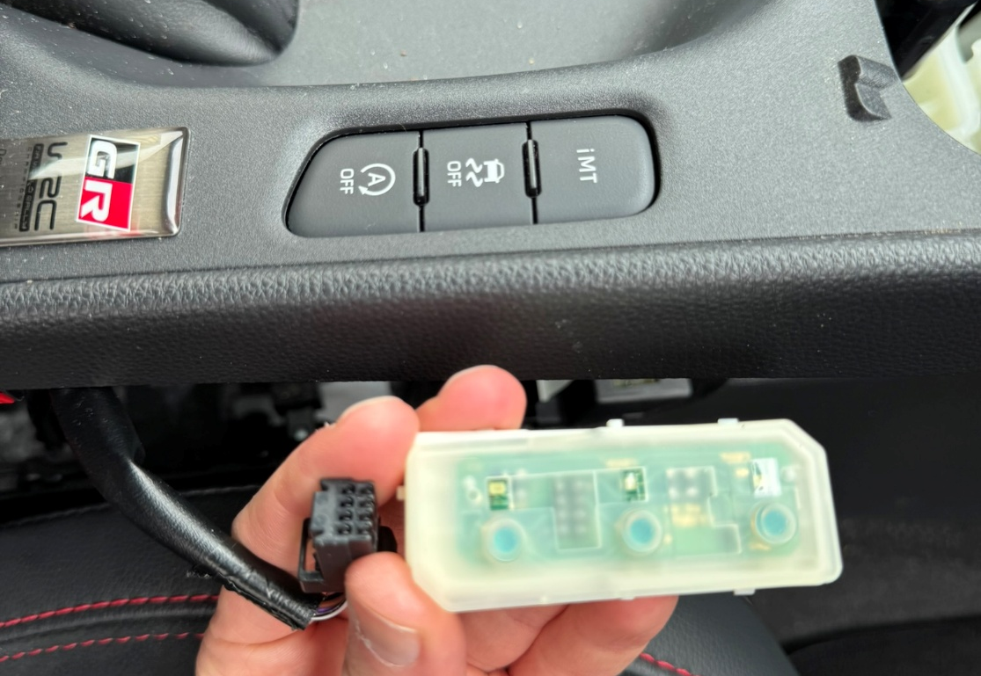
7. iMT, ESC, Auto Stop/Start
The wiring loom needed for iMT, ESC, and Auto Stop/Start is found under the centre console
(plugged into the iMT/ESC/Auto stop start button)
Pin number 8 (Black) = iMT
Pin number 7 (Purple) = Stability/Traction Control (ESC)
Pin number 6 (Black) = Auto stop/start (ASS)
4
3
2
1
8
7
6
5
This 8-pin connector is:
Plug: Tokai Rika 4A1330-000 (Toyota 90980-12910)
Socket: Tokai Rika 4B1160-000

Slide 8
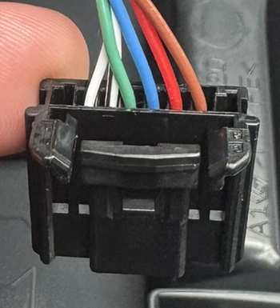
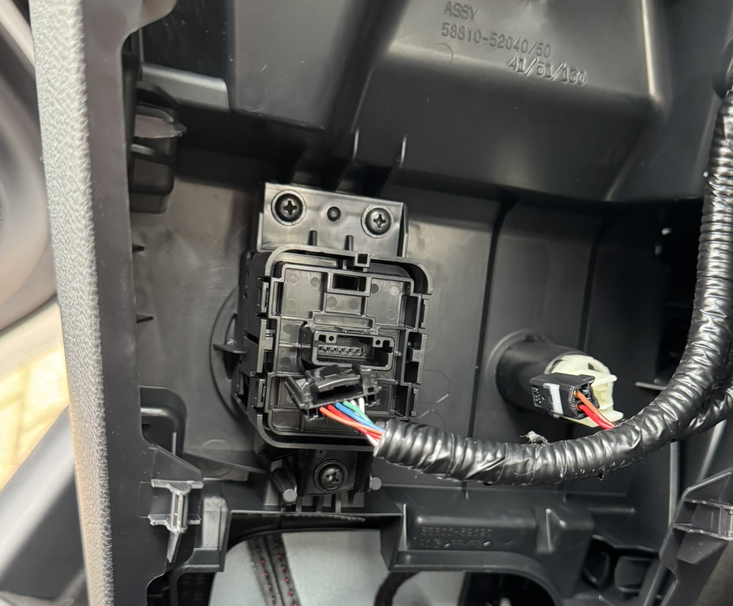
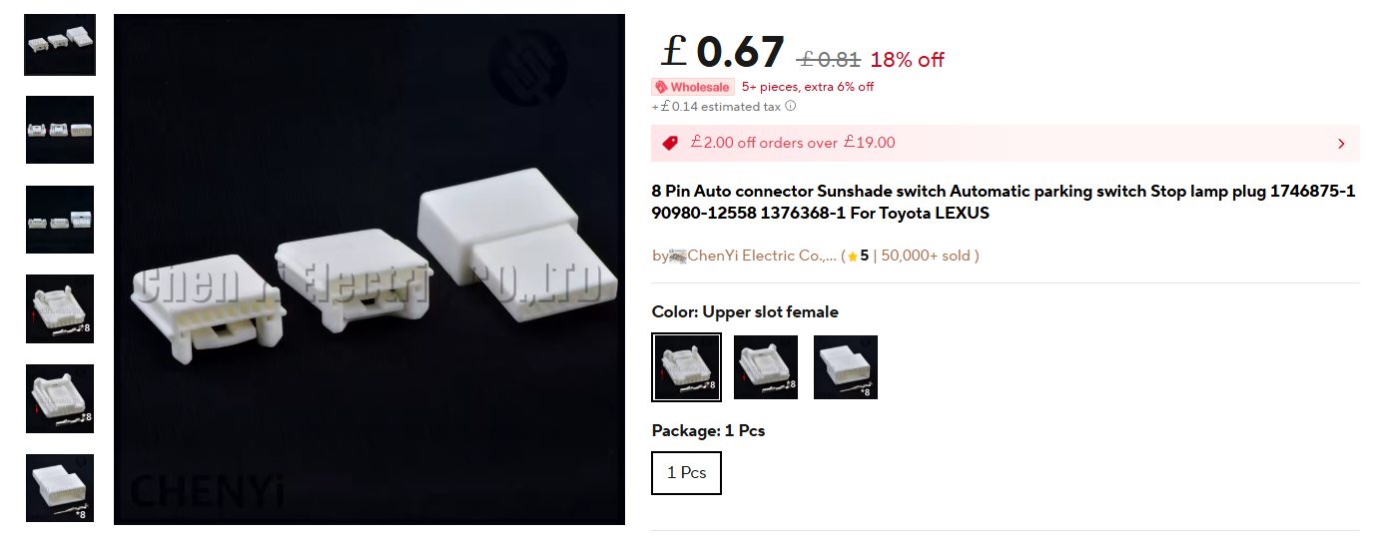
8. Sport / Track Mode
The wiring loom needed for Sport/Track mode select is found under the centre console
(plugged into the drive mode rotary button)
Pin number 4 (Green) = Sport (SPRT)
Pin number 6 (Red) = Track (TRCK)
(Note pins 1 and 8 are unpopulated in the plug but still counted here)
You can wire both sport and track into the controller and use the slide switch on the PCB to choose between them. The slide switch must be in the appropriate position if you decide to wire only Sport or Track.
If you don’t want to splice into the factory wiring, a short extension harness can be made up using these connectors:
8-pin plug + socket + crimp pins
(choose the “Upper slot female” version)
1
2
3
4
5
6
7
8

Slide 9
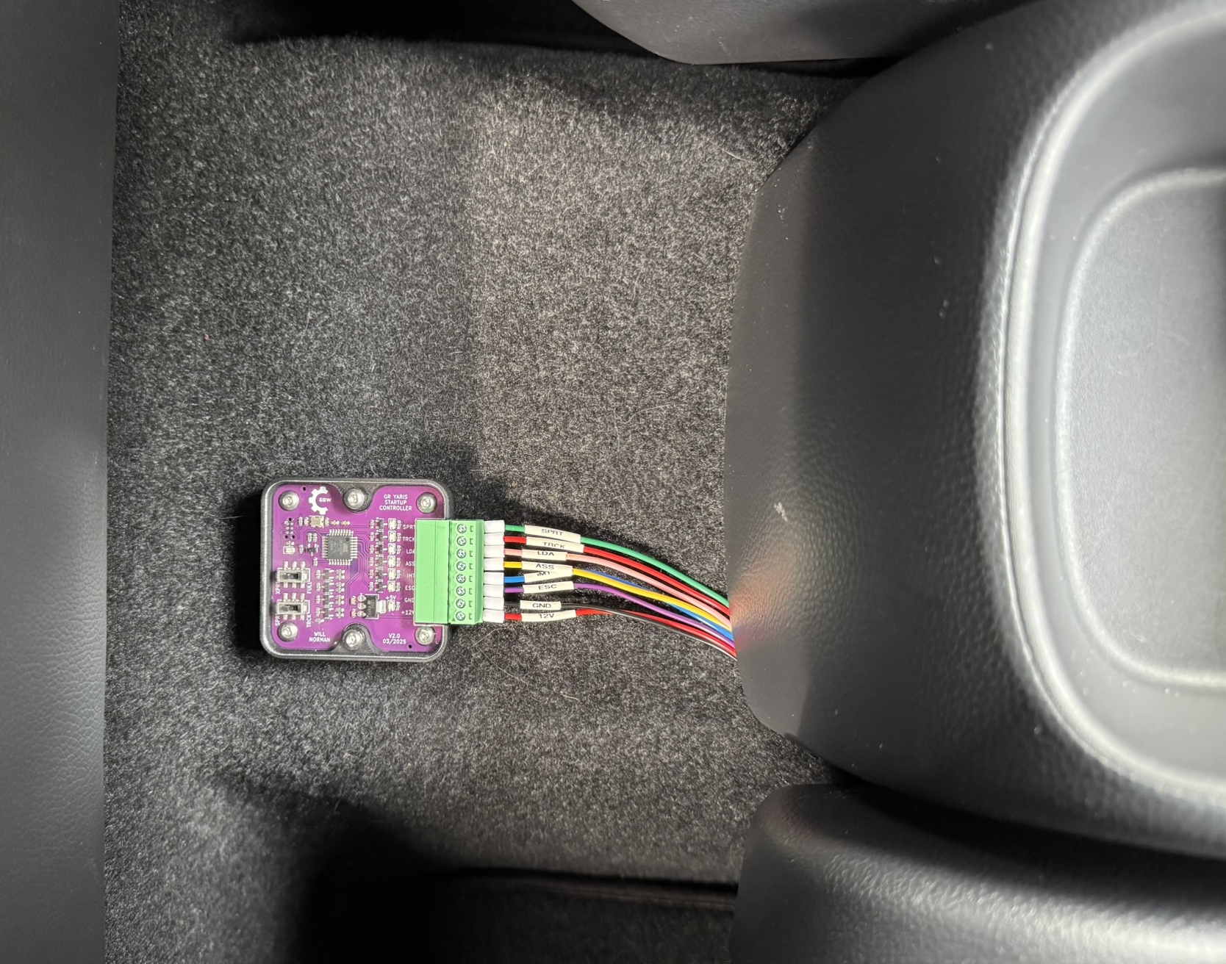
9. Helpful Links
Demo video
Project files and information on GitHub
Link to forum post where idea initially discussed by MagnusT
How to pull apart the centre console
22 AWG wire
I’ve chosen to wire mine to the rear of the centre console
(for easy access during development)

Slide 10
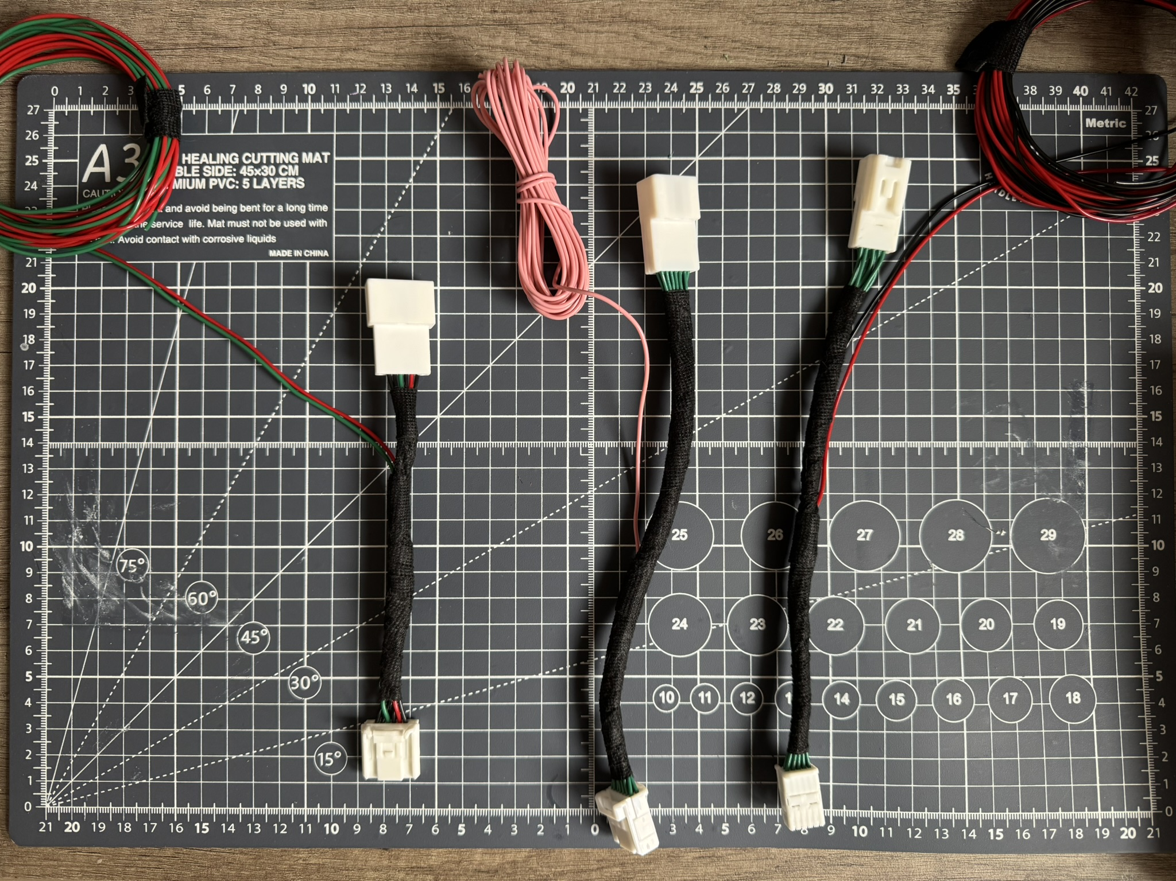
10. Extension Harnesses
Power & Ground
10-pin extension harness
Another 10-pin option that should work
Lane Departure Alert: 14-pin extension harness
Sport/Track Mode: 8-pin plug + socket + crimp pins (upper slot female version)
1
2
3

